Slide 1


Litty Tressa George
FICT

Slide 2
ANN- Contents Covered
Motivation for ANN
Biological Neuron & BNN
Single Biological neuron structure , its components & their functions.
Working Principle of BNN
Introduction To ANN , basic concepts and formal definition.
ANN development Era
Analogy between BNN & ANN
Activation Functions , their need & different types.
Perceptrons
Working Principle of Perceptrons
Perceptron Learning & Perceptron learning algorithm.
Error identification and calculation
Error correction by updating weights.
Limitations of perceptrons.

Slide 3
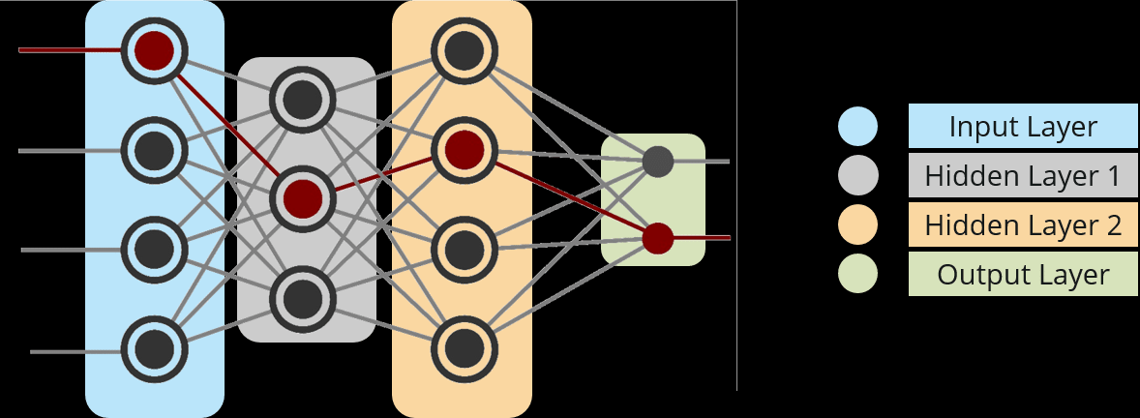
Multi Layer Neural Network
A typical architecture for a multilayer neural network is shown in Figure.
The network consists of one input layer, two hidden layer and one output layer.
A fully connected multi-layer neural network is called a Multilayer Perceptron (MLP).
Fig: A Multilayer Perceptron with two hidden layers

Slide 4
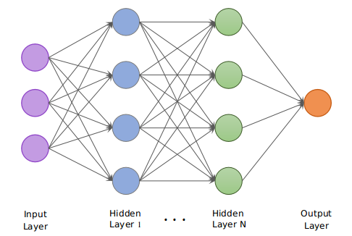
Multi Layer Neural Networks
The network shown is a feed-forward network. A Multilayer neural network is often called as a feed forward neural network because output from one layer of neurons are feeded or propagated in forward direction to next layer of neurons.

Slide 5
Multi Layer Neural Network
Input Nodes – The Input nodes provide information from the outside world to the network and are together referred to as the “Input Layer”. No serious processing is performed in any of the Input nodes – they just pass on the information to the hidden nodes.
Hidden Nodes – The Hidden nodes have no direct connection with the outside world (hence the name “hidden”). They perform computations and transfer information to the output nodes. A collection of hidden nodes forms a “Hidden Layer”. While a network will only have a single input layer and a single output layer, it can have one or multiple Hidden Layers, ideally most practical applications uses three, because each additional layer increases the computational burden exponentially. (experimental n/w may have five or even six). A hidden layer ‘hides’ its desired output. In other words, the desired output of the hidden layer is determined by the layer itself. A Multi-Layer Perceptron has one or more hidden layers.
Output Nodes – The Output nodes are collectively referred to as the “Output Layer” and are responsible for computations and transferring information from the network to the outside world.

Slide 6
A multilayer neural network can represent a very broad set of nonlinear functions which perceptron's couldn’t.
This structure is called multilayer because it has a layer of processing units (i.e., the hidden units) in addition to the output units.
The connections never skip a layer.
Typically, the layers are fully connected, meaning that all units at one layer are connected with all units at the next layer.
So, this means that all input units are connected to all the units in the layer of hidden units, and all the units in the hidden layer are connected to all the output units.
The network is called feed-forward because data are fed in forward direction from the input nodes through hidden nodes to the output nodes.
A typical neural network consists of an input layer, one or more hidden layers, and an output layer, and each layer may have any no : of neurons in between 10 and 1000

Slide 7
Backpropagation
Multilayer neural networks learn almost in the same way as single perceptron's.
The main difference is that in a multilayer network, there are plenty of neurons and each neuron has weights associated with its inputs, and so there are a far greater number of weights to be adjusted when an error is made with a single piece of training data.
A single neuron have weighted input connections /links to all the neurons in the next layer.
How to update the weights associated with all the neurons ?
More than a hundred different learning algorithms are available, but the most popular method is back-propagation.
This method was first proposed in 1969 (Bryson and Ho, 1969), but was ignored because of its demanding computations.
Only in the mid-1980s was the back-propagation learning algorithm rediscovered.

Slide 8
Backpropagation
Back-propagation is the essence of neural net training. It is the practice of fine-tuning the weights of a neural net based on the error rate (i.e. loss) obtained in the previous epoch (i.e. iteration).
Proper tuning of the weights ensures lower error rates, making the model reliable by increasing its generalization ability.
Updation of weights starts from the back end of the network (last layer/output layer) towards front end (first layer/ input layer) in reverse manner, layer by layer . That’s why its termed as Backpropagation.

Slide 9
How Backpropagation Algorithm Works
In a back-propagation neural network, the learning algorithm has two phases.
First, a training input pattern is presented to the network input layer.
The network then propagates the input pattern from layer to layer until the output pattern is generated by the output layer.
If this generated pattern is different from the desired output, an error is calculated and then propagated backwards through the network from the output layer through the hidden layers to the input layer.
The weights of all neurons in each layer are modified as the error is propagated.
As with any neural network, a back-propagation depends on the connections between neurons (the network’s architecture), the activation function used by the neurons, and the learning algorithm (or the learning law) that specifies the procedure for adjusting weights.
Typically, a back-propagation network is a multilayer network that has three or four layers.
The layers are fully connected, that is, every neuron in each layer is connected to every other neuron in the adjacent forward layer.

Slide 10

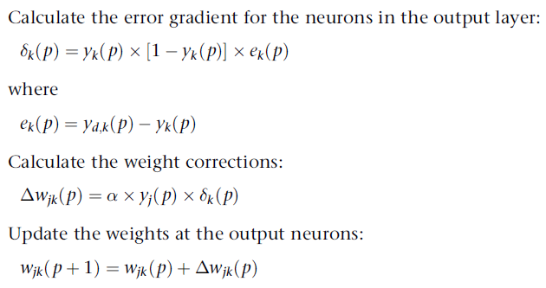
Backpropagation
Note:
If k is a neuron in outer layer, Error gradient represented by Delta k is the product of output value of neuron k* (1-that value)* error obtained at neuron k
Error at neuron k is the desired /target output at k ,that is Yd,k minus obtained output at k Yk
Rate of change of weight

Slide 11
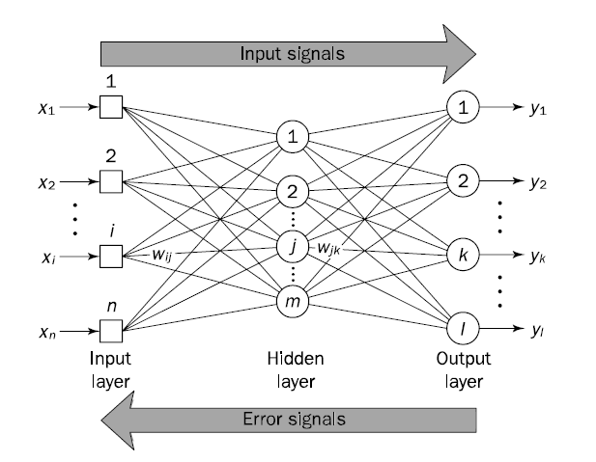
How Backpropagation Works

Slide 12
Why We Need Backpropagation?
Most prominent advantages of Backpropagation are:
It has no parameters to tune apart from the inputs and weights.
It is a flexible method as it does not require prior knowledge about the network
It is a standard method that generally works well
It does not need any special mention of the features of the function to be learned.

Slide 13
Most prominent disadvantages of Backpropagation are:
The actual performance of backpropagation on a specific problem is dependent on the input data.
Backpropagation can be quite sensitive to noisy data

Slide 14

Rather than using the simple Step function that single perceptron's use, multilayer backpropagation networks usually use the sigmoid function,
The sigmoid function is defined as follows:
Note: sigmoid function cannot actually reach 0 or 1, it is usual to accept a value such as 0.9 as representing 1 and 0.1 as representing 0.

Slide 15
Activity
1. List down the Methodologies for Improving the Performance of Backpropagation
Reference Text : Artificial Intelligence Illuminated , chapter 11 , Page 305
2. In light of the learned back- propagation concept, state the basic back- propagation algorithm steps with necessary equations.
Reference Text : Artificial Intelligence- A guide to intelligent systems , chapter 6, page 179

Slide 16
Learning, in artificial neural network, is the method of modifying the weights of connections between the neurons of a specified network.
Learning in ANN can be classified into three categories namely:
Supervised Learning,
Unsupervised Learning,
Reinforcement Learning.

Slide 17
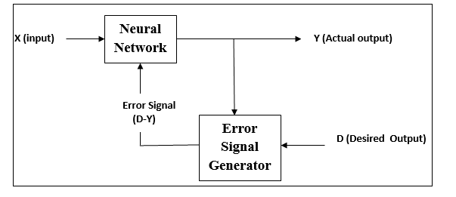
Supervised Learning
As the name suggests, this type of learning is done under the supervision of a supervisor.
This learning process is dependent.
During the training of ANN under supervised learning, the input vector is presented to the network, which will give an output vector. This output vector is compared with the desired output vector. An error signal is generated, if there is a difference between the actual output and the desired output vector. On the basis of this error signal, the weights are adjusted until the actual output is matched with the desired output.

Slide 18
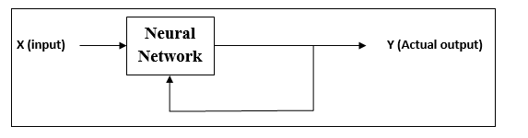
Unsupervised Learning
As the name suggests, this type of learning is done without the supervision .
This learning process is independent.
During the training of ANN under unsupervised learning, the input vectors of similar type are combined to form clusters. When a new input pattern is applied, then the neural network gives an output response indicating the class to which the input pattern belongs.
There is no feedback from the environment as to what should be the desired output and if it is correct or incorrect. Hence, in this type of learning, the network itself must discover the patterns and features from the input data, and the relation for the input data over the output.

Slide 19
Reinforcement Learning
As the name suggests, this type of learning is used to reinforce or strengthen the network over some critic information. This learning process is similar to supervised learning, however we might have very less information.
During the training of network under reinforcement learning, the network receives some feedback from the environment. This makes it somewhat similar to supervised learning. However, the feedback obtained here is evaluative not instructive, which means there is no supervisor as in supervised learning. After receiving the feedback, the network performs adjustments of the weights to get better critic information in future.

